Slide 1











X
HAC
ERVE
2.O
Where Innovation Meets Service
HARDWARE EDITION
Team Name: [ROBOT ASPIRANTS]
College Name: [SIDDAGANGA INSTITUTE OF TECHNOLOGY , KARNATAKA]
Domain:[ROBOTICS AND AUTOMATION]
Problem Statement: [Designing a fully autonomous farm robot capable of monitoring the field, identifying and collecting vegetables, and sorting them into bins without human intervention.]

Slide 2


OBJECTIVES OF PROBLEM STATEMENT
X
1)To develop an autonomous mobile robot that can navigate and operate in farmland without human assistance.
2)To detect and classify various vegetables (e.g., tomato, brinjal, ladyfinger) using a Raspberry Pi camera and a trained ML model.
3)To collect and sort vegetables using a robotic arm into separate bins based on their type.
4)To monitor bin capacity using ultrasonic or IR sensors and notify the farmer when bins are full.
5)To detect unauthorized intrusions (animals or humans) using an AI-powered camera trained with a custom dataset.
6)To notify the farmer in real time through a smartphone dashboard and smart alerts via WhatsApp/Telegram.
7)To maintain offline reliability with local data backup (SD card) and battery monitoring for continuous operation.
HAC
ERVE
2.O

Slide 3
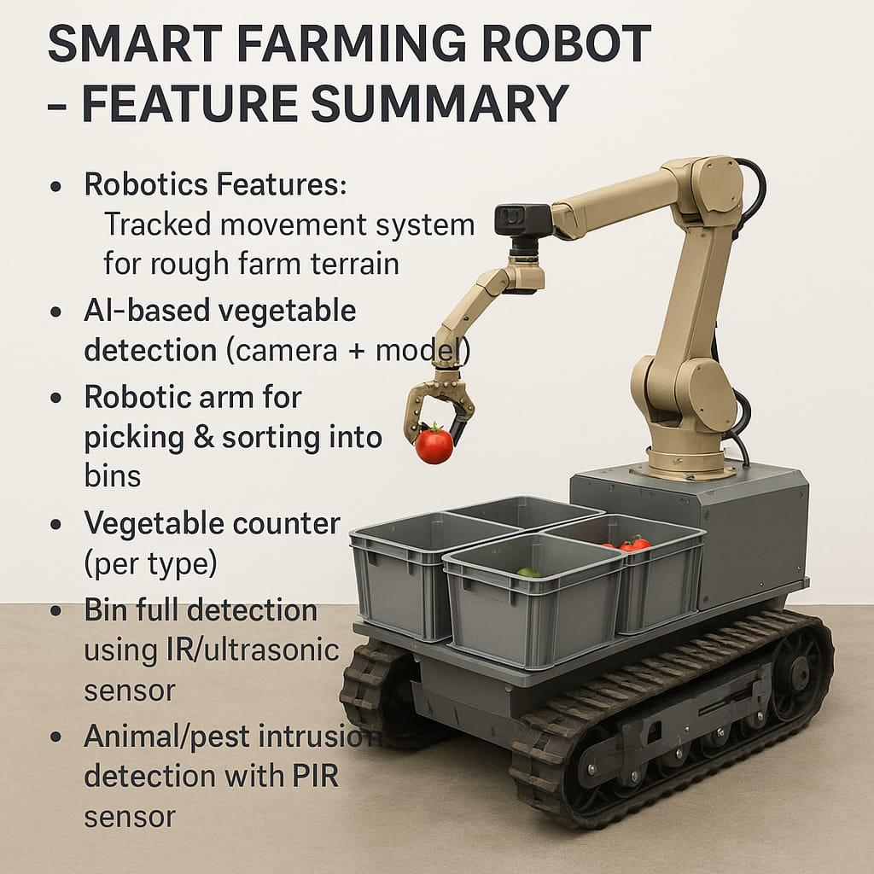
APPROACH AND TECHNOLOGY STACK
BRIEFLY DESCRIBE YOUR SOLUTION APPROACH HERE:
X
Our solution is a fully autonomous smart farming robot that assists farmers in post-harvest vegetable collection and field monitoring. The robot is equipped with a Raspberry Pi camera and a trained machine learning model to identify and classify vegetables like tomato, brinjal, and ladyfinger. Once identified, a robotic arm collects the vegetables and sorts them into separate onboard bins mounted on the robot. The robot navigates through the field using a tracked movement system suitable for rough terrain. Bin levels are monitored using ultrasonic or IR sensors, and the farmer receives real-time alerts via WhatsApp/Telegram when bins are full or if any unauthorized human or animal is detected through AI-powered camera surveillance. This solution eliminates manual labor, increases efficiency, and ensures continuous autonomous operation on the farm.
HAC
ERVE
2.O

Slide 4
ARCHITECTURE
X
DESCRIBE THE ARCHITECTURE WITH DIFFERENT COMPONENTS OF THE PROPOSED SOLUTION:
HAC
ERVE
The proposed solution is a fully autonomous smart farming robot that integrates hardware, AI, and IoT components to perform vegetable collection, sorting, and field monitoring. The architecture includes the following core components:
1. Raspberry Pi (Central Controller)
Acts as the brain of the system
Runs the trained machine learning model
Controls all hardware modules and sensors
4. Robotic Arm (Servo Motor Based)
Picks up detected vegetables
Sorts and places them into separate bins mounted on the robot
7. IR/Ultrasonic Sensors
Placed above each bin to detect when it's full
Sends signal to alert system when capacity is reached
2.O
5. Mounted Storage Bins
Three or more bins attached to the robot
Each bin holds a different type of vegetable
Fitted with ultrasonic/IR sensors to detect fullness
8. Battery & Power Management
Powers the robot, sensors, and camera
Includes battery level detection and low-power alert system
2. Pi Camera
Captures real-time images of crops and intruders
Feeds input to the ML model for vegetable classification and intrusion detection
3. Machine Learning Model (Vegetable & Intruder Detection)
Custom-trained using TensorFlow or TFLite
Identifies different vegetables (e.g., tomato, brinjal, ladyfinger)
Detects unauthorized human or animal presence
6. Tracked Chassis + Motor Driver (L298N)
Allows movement over uneven farm terrain
Controlled by the Raspberry Pi via motor driver circuit
9. IoT Module (Firebase / Wi-Fi)
Sends real-time data (vegetable count, bin status, intrusion alert) to a mobile dashboard
Triggers WhatsApp/Telegram alerts to the farmer

Slide 5
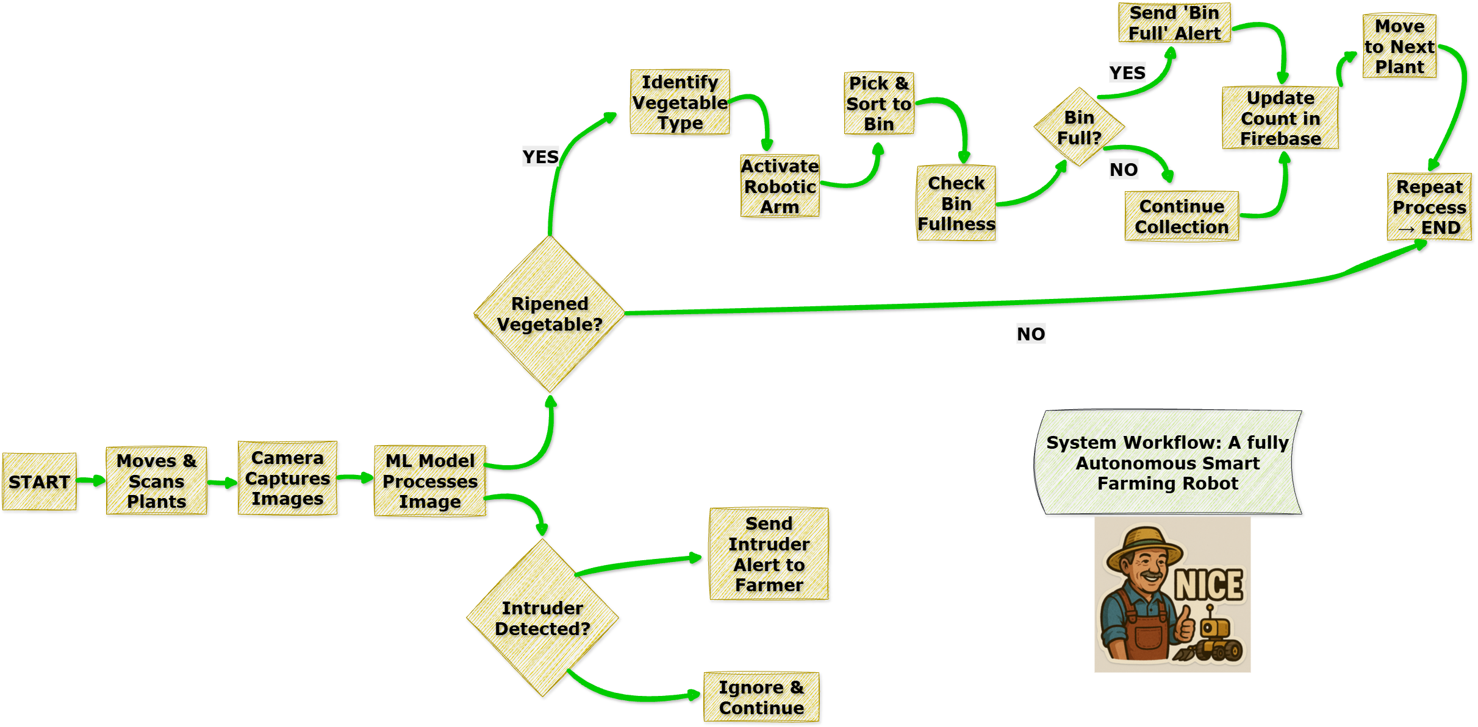
X
HAC
ERVE
2.O

Slide 6
FEASIBILITY AND IMPACT
Feasibility
The system is built using affordable, readily available components like Raspberry Pi, ultrasonic sensors, servo motors, and a Pi camera.
The AI model can be trained on a custom vegetable dataset and optimized using TensorFlow Lite, suitable for edge computing.
The robot uses a track-based movement system, enabling it to navigate uneven farmland terrain efficiently.
The entire setup is modular and scalable—can be customized per farm size and number of vegetable types.
Powered by a rechargeable battery, with low-power consumption and capability for offline storage when network isn't available.
Can be developed as a proof of concept in a low-cost prototype and improved with better materials for durability.
Impact
Reduces the need for manual labor, helping farmers during harvesting when labor shortages are common.
Increases efficiency by automating sorting and collection of multiple vegetable types with minimal errors.
Prevents crop loss due to late harvest or human/animal intrusion with real-time alerts.
Empowers small/marginal farmers who often cannot afford large-scale automation solutions.
Promotes digital agriculture and rural innovation, aligning with national missions like “Digital India” and “Smart Villages.”
Can be adapted to different crops and regions, making it a flexible rural-tech solution.
Reduce labour cost that increase day by day
X
HAC
ERVE
2.O

